Slide 1

Sales Data Analysis
By Rajvinder Kaur

Slide 2

Objective: Analyze Sales Data using Excel to identify trends and generate insights
Utilized Advanced Excel(Vlookup Function, DateValue Function, Month Function), Pivot Tables, and Data Visualization to analyze sales data, identify trends, and generate insights.

Slide 3

The fictitious company dataset contains order id, customers demographics, sales amount and profit generated over the year 2018 in India.
https://github.com/TheMrityunjayPathak/RetailStoreSalesDashboard/blob/main/Dataset/Details.csv

Slide 4
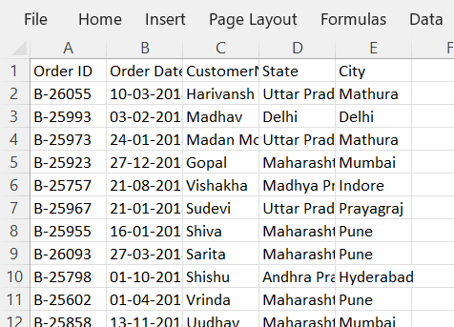
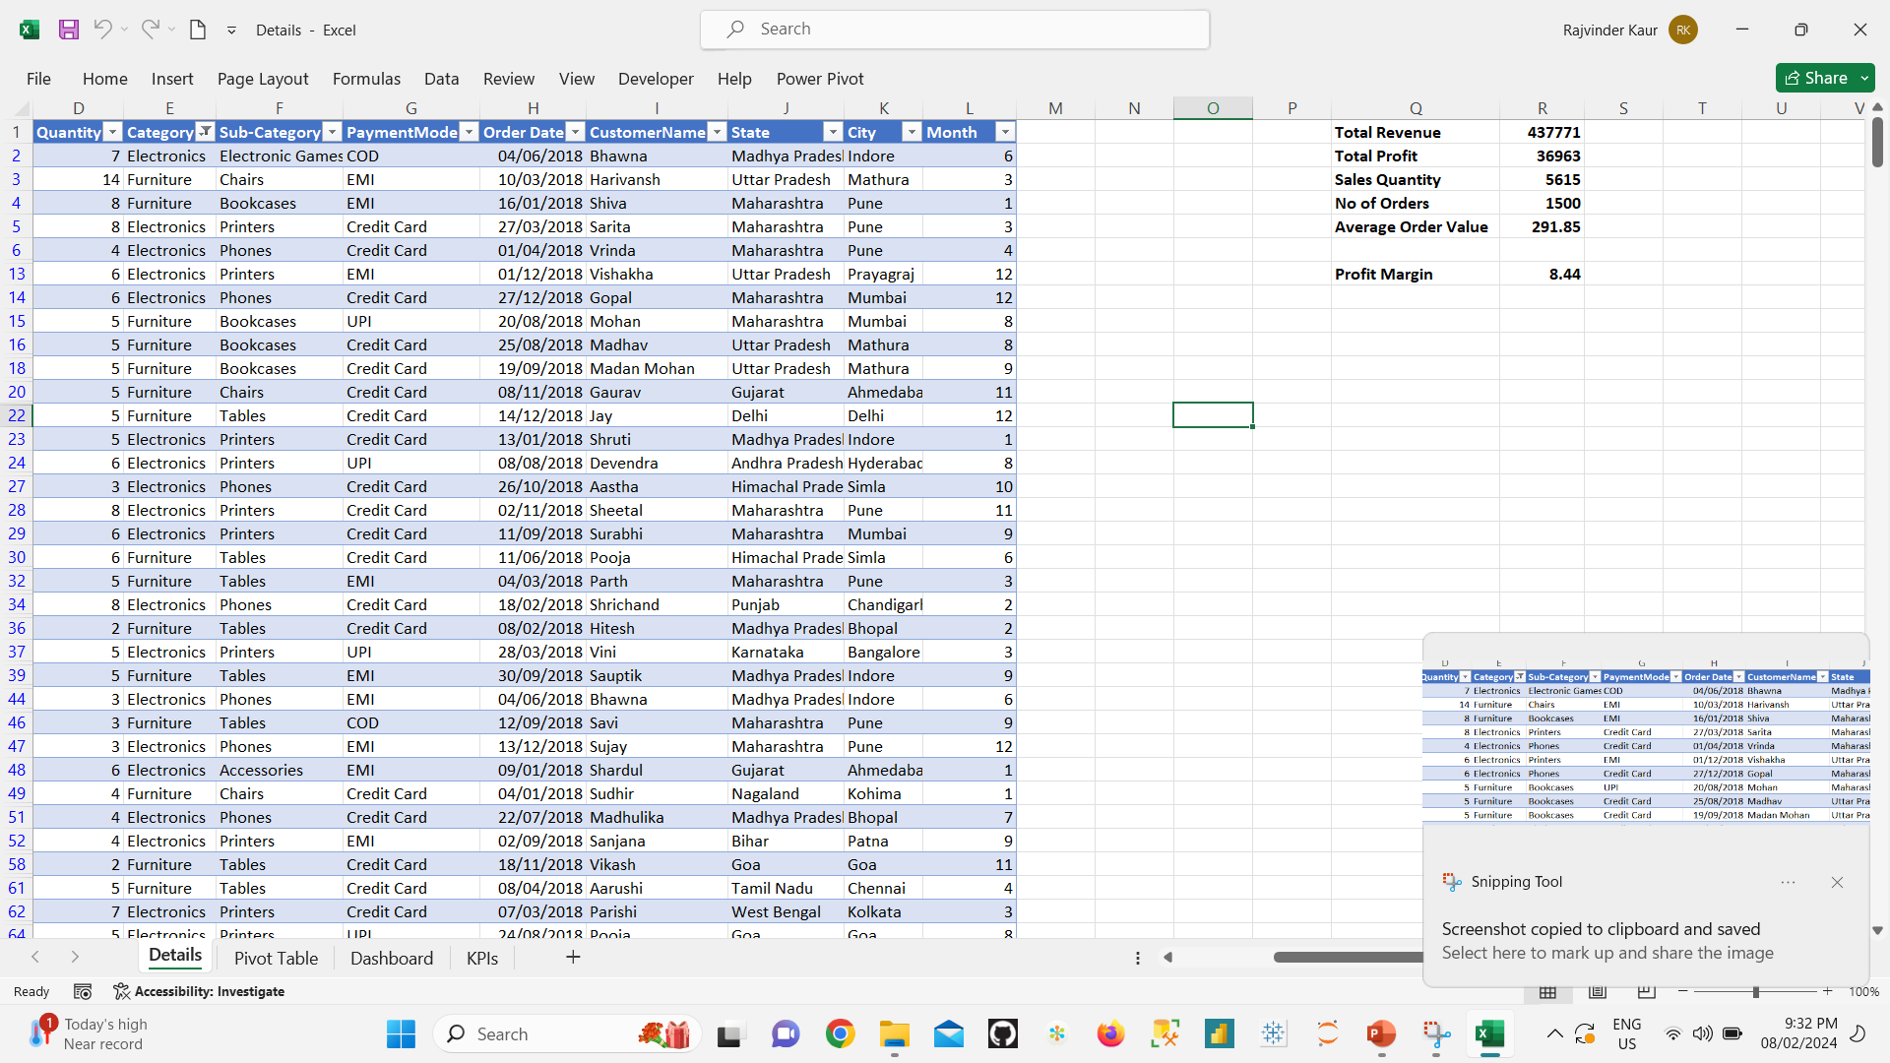
This data contains two worksheet Orders and details.
Data from Orders is imported in Details using Vlookup Function.
DateValue function is used to change the format from text to date.
Dataset and system date format was different so need to change system date format.
Month function to extract month number from date.

Slide 5
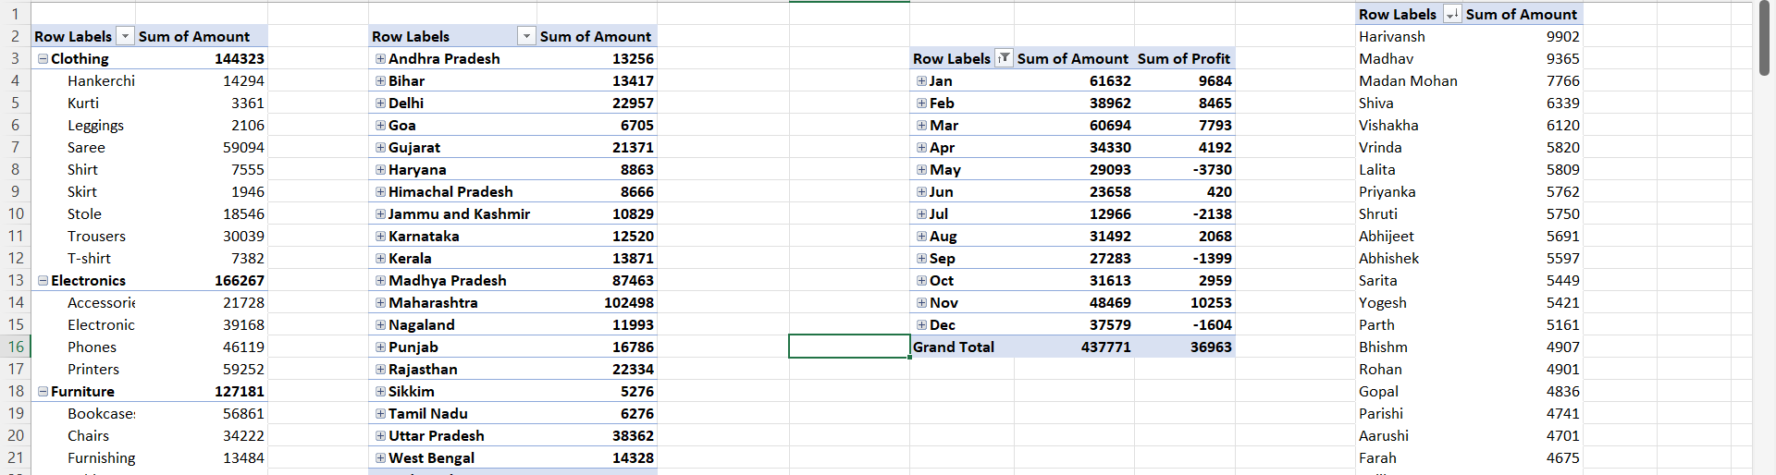
Created Pivot tables to aggregate data for creating charts.
Created KPIs for Total Revenue, Sales Quantity, Profit Margin, Total Profit, and Average Order Value for the visualizations.

Slide 6
Revenue and Profit changing over the months.
Decline in sales and profit is noticed.

Slide 7
Maximum sales is generated by bookcases, printers, clothing saree.
Skirt, legging and Kurtis are least selling products. Company can improve marketing strategies on less selling products.

Slide 8
Madhya Pradesh and Maharashtra are contributing in most of the sales.
Company should implement marketing strategies in other states like Tamil Nadu, Sikkim, Himachal Pradesh, Haryana.

Slide 9
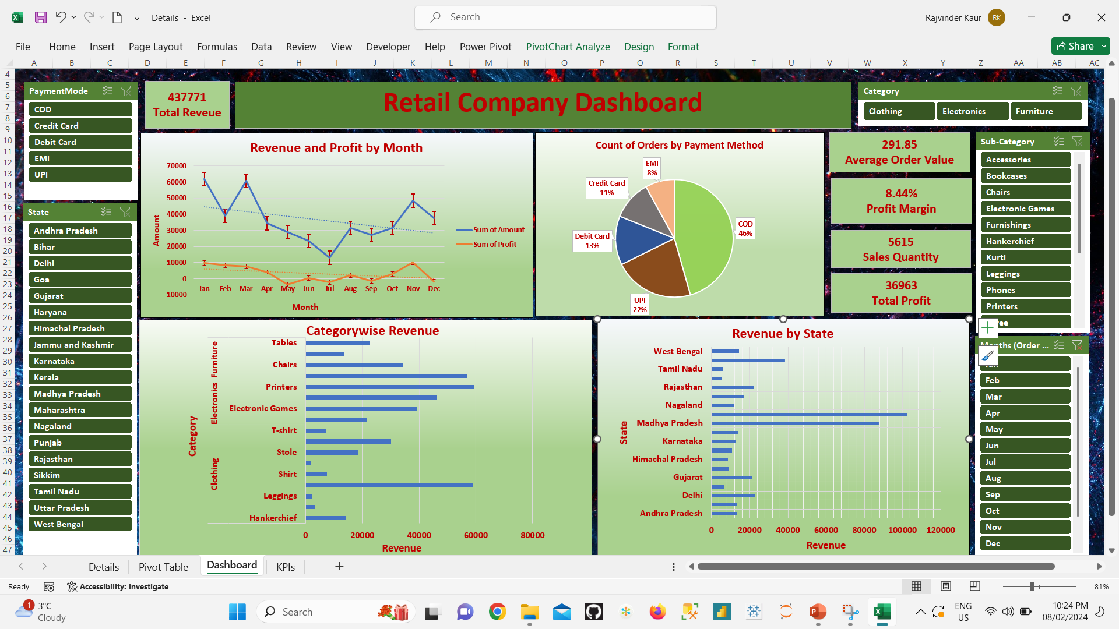

Slide 10

In the first Quarter of the year sales was quite good, that same strategy should be applied for other quarters as well.
Skirt, legging and Kurtis are least selling products. Company can improve marketing strategies on less selling products.
Company should implement new marketing strategies in states like Tamil Nadu, Sikkim, Himachal Pradesh, Haryana which are contributing less in sales.
Company could give some coupons or discount on the less selling products to increase its sale.
Company should work on the advertisement campaigns to make people aware about the existing and upcoming products.

Slide 11

Thank You

